Slide 1
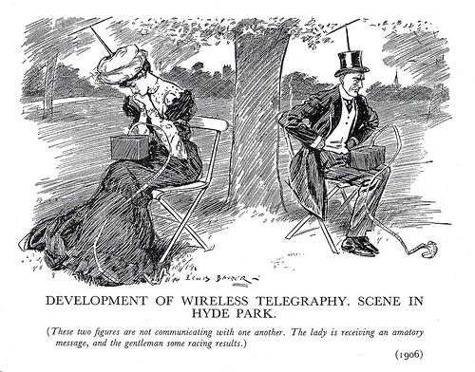
This picture is from 1906
How accurate has this prediction been?
Source: http://www.flickr.com/photos/kipw/8376981950/in/photostream/

